Slide 1

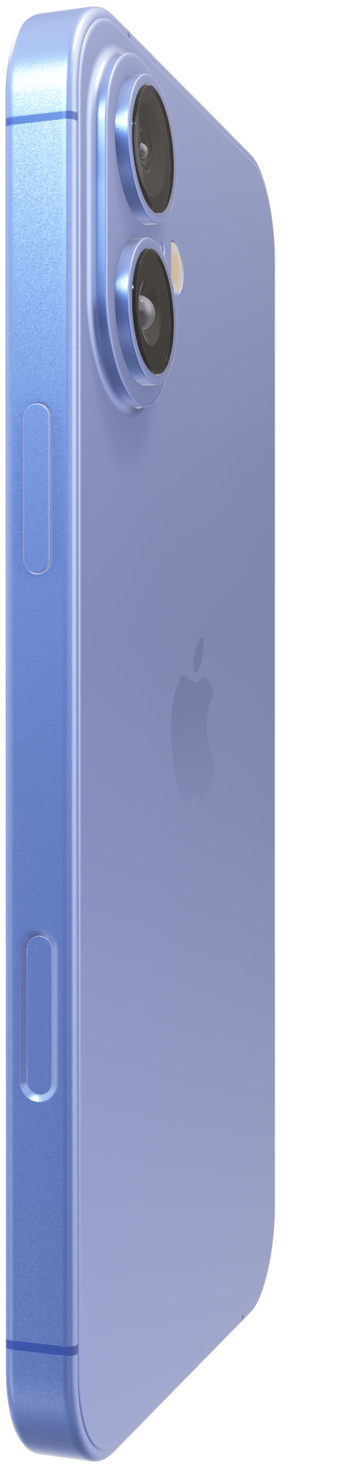
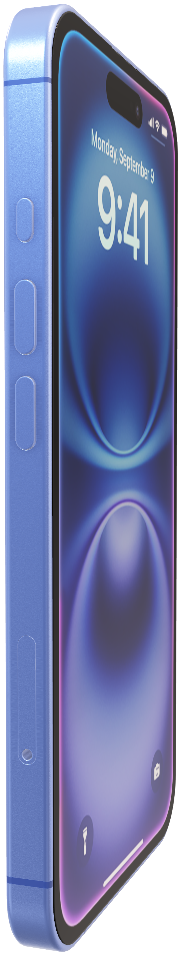
Analog Computer
EN2091 - Laboratory Practice and Projects.

Slide 2


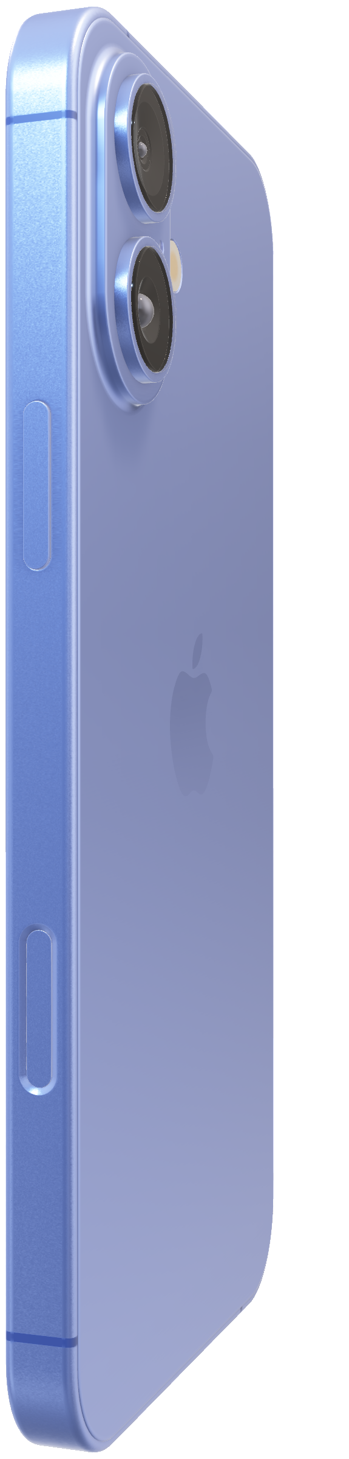
Analog Computer
EN2091 - Laboratory Practice and Projects.

Slide 3
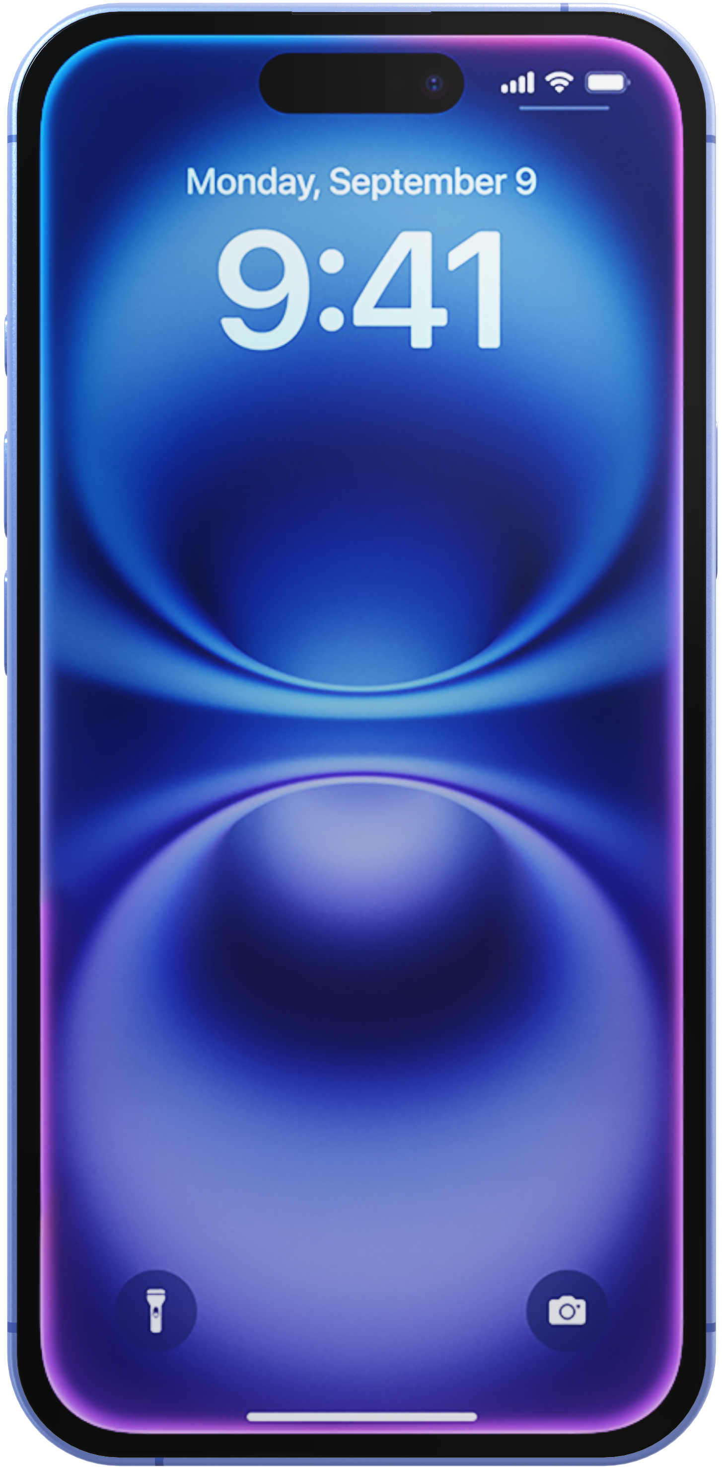
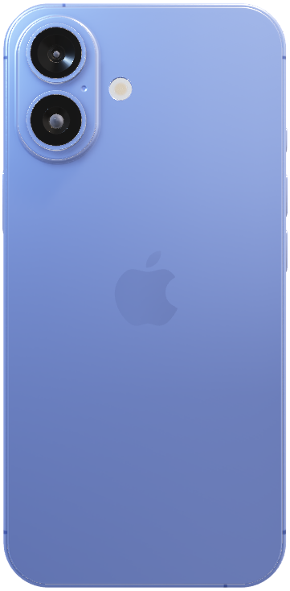
Analog Computer
EN2091 - Laboratory Practice and Projects.
The first iPhone built for Apple Intelligence. Personal, private, powerful.
Analog Computing.
Precision in every operation.
Coming this fall.

Slide 4
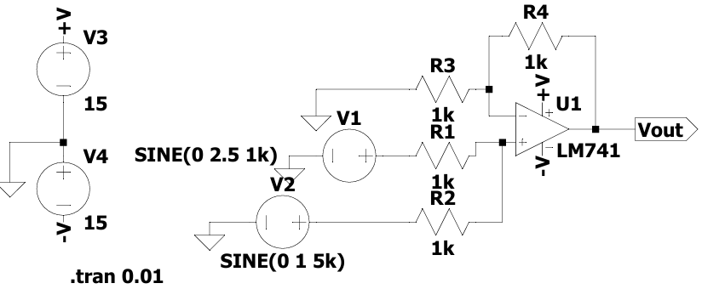
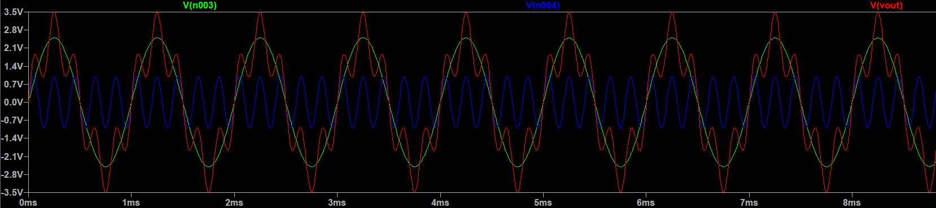
Simulation Results.
Adder Circuit.

Slide 5
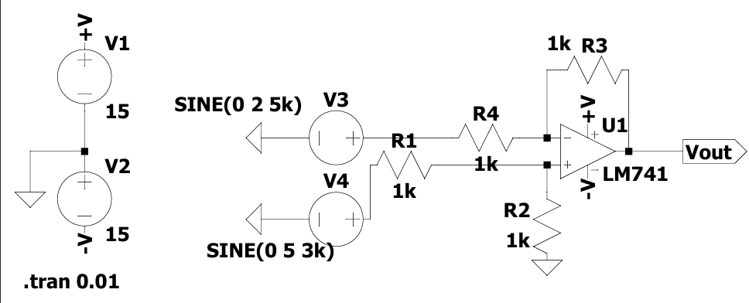
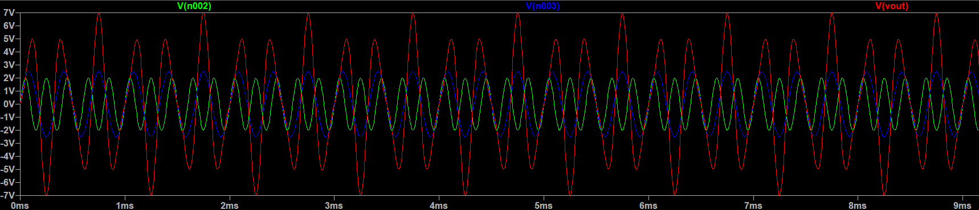
Simulation Results.
Subtractor Circuit.

Slide 6
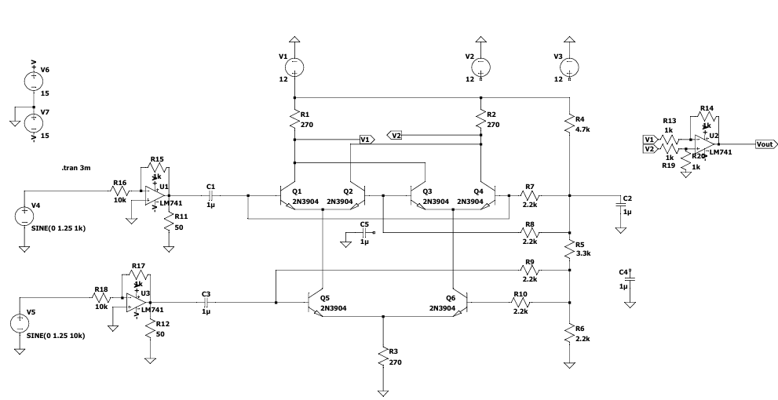
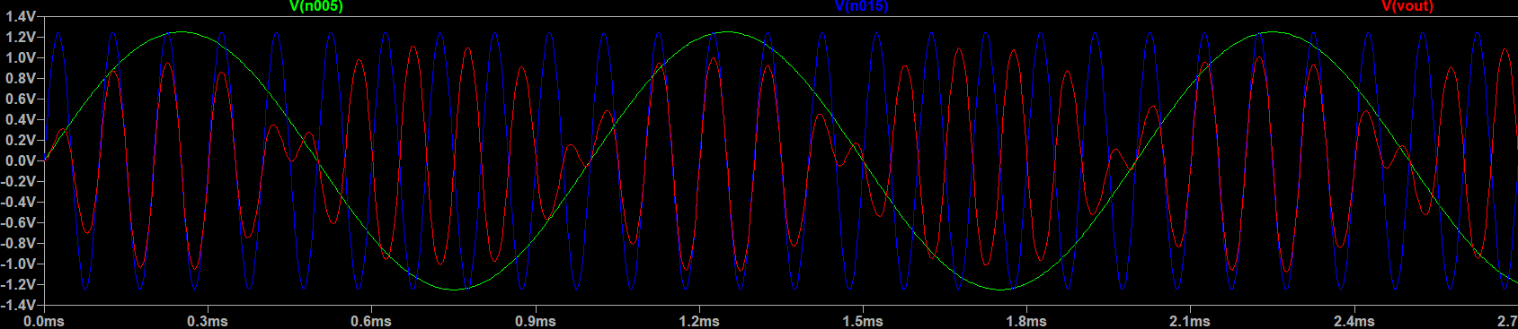
Simulation Results.
Multiplier Circuit.

Slide 7
Simple Design.
Do More. With Ease.

Slide 8


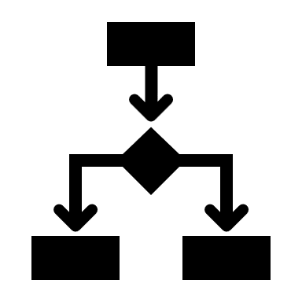



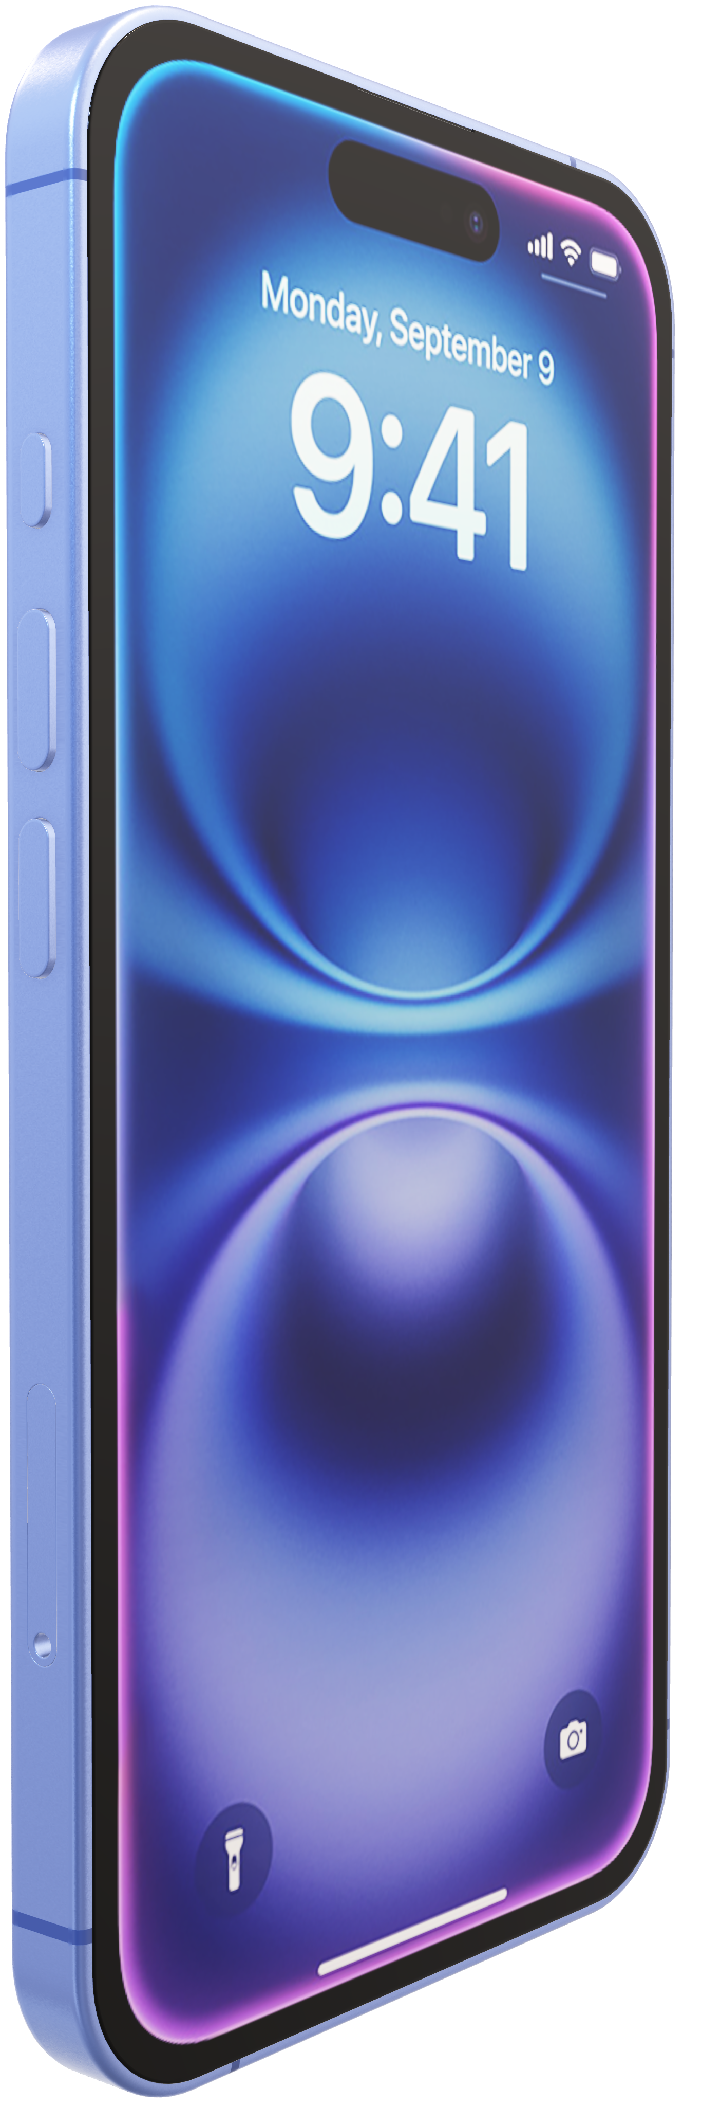
Action button.
Do more. Wait less.
The Action button on iPhone 16 is a fast track to your favorite feature. Just press and hold to launch the action you want — the flashlight, a voice memo, Silent mode, and more. You can also set up Shortcuts to open an app, run a series of tasks, or change actions depending on the time of day or your location. Or use it to take actions in an app, like setting an alarm or even ordering your favorite coffee drink.
Parelle operation modes
Adjustable gain controls
Dual-channel input interfaces
Stable power supply design
Wide frequency range
High Accuracy and minimal distortion

Slide 9


Action button.
Do more. Wait less.
The Action button on iPhone 16 is a fast track to your favorite feature. Just press and hold to launch the action you want — the flashlight, a voice memo, Silent mode, and more. You can also set up Shortcuts to open an app, run a series of tasks, or change actions depending on the time of day or your location. Or use it to take actions in an app, like setting an alarm or even ordering your favorite coffee drink.
Parelle operation modes
Adjustable gain controls
Dual-channel input interfaces
Stable power supply design
Wide frequency range
High Accuracy and minimal distortion

Slide 10

Action button.
Do more. Wait less.
The Action button on iPhone 16 is a fast track to your favorite feature. Just press and hold to launch the action you want — the flashlight, a voice memo, Silent mode, and more. You can also set up Shortcuts to open an app, run a series of tasks, or change actions depending on the time of day or your location. Or use it to take actions in an app, like setting an alarm or even ordering your favorite coffee drink.
Parelle operation modes
Adjustable gain controls
Dual-channel input interfaces
Stable power supply design
Wide frequency range
High Accuracy and minimal distortion

Slide 11

Action button.
Do more. Wait less.
The Action button on iPhone 16 is a fast track to your favorite feature. Just press and hold to launch the action you want — the flashlight, a voice memo, Silent mode, and more. You can also set up Shortcuts to open an app, run a series of tasks, or change actions depending on the time of day or your location. Or use it to take actions in an app, like setting an alarm or even ordering your favorite coffee drink.
Parelle operation modes
Adjustable gain controls
Dual-channel input interfaces
Stable power supply design
Wide frequency range
High Accuracy and minimal distortion

Slide 12

Action button.
Do more. Wait less.
The Action button on iPhone 16 is a fast track to your favorite feature. Just press and hold to launch the action you want — the flashlight, a voice memo, Silent mode, and more. You can also set up Shortcuts to open an app, run a series of tasks, or change actions depending on the time of day or your location. Or use it to take actions in an app, like setting an alarm or even ordering your favorite coffee drink.
Parelle operation modes
Adjustable gain controls
Dual-channel input interfaces
Stable power supply design
Wide frequency range
High Accuracy and minimal distortion

Slide 13

Action button.
Do more. Wait less.
The Action button on iPhone 16 is a fast track to your favorite feature. Just press and hold to launch the action you want — the flashlight, a voice memo, Silent mode, and more. You can also set up Shortcuts to open an app, run a series of tasks, or change actions depending on the time of day or your location. Or use it to take actions in an app, like setting an alarm or even ordering your favorite coffee drink.
Parelle operation modes
Adjustable gain controls
Dual-channel input interfaces
Stable power supply design
Wide frequency range
High Accuracy and minimal distortion

Slide 14
Action button.
Do more. Wait less.
The Action button on iPhone 16 is a fast track to your favorite feature. Just press and hold to launch the action you want — the flashlight, a voice memo, Silent mode, and more. You can also set up Shortcuts to open an app, run a series of tasks, or change actions depending on the time of day or your location. Or use it to take actions in an app, like setting an alarm or even ordering your favorite coffee drink.
Parelle operation modes
Adjustable gain controls
Dual-channel input interfaces
Stable power supply design
Wide frequency range
High Accuracy and minimal distortion

